Slide 1
Fundamentals of Web Development
Server-Side Development : PHP

Slide 2
you will learn . . .
What is server-side development
PHP language fundamentals
PHP syntax , arrays, and functions

Slide 3
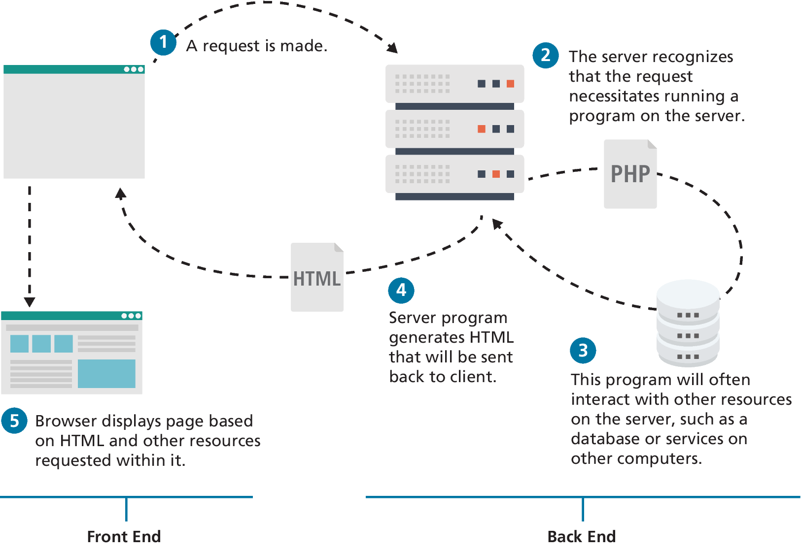
Front End versus Back End
Server-side technologies provide access to data sources, handled security, and allowed web sites to interact with external services such as payment systems.
Traditionally, most sites made use programs running on the server-side to programmatically generate the HTML sent to the browser.

Slide 4
Common Server-Side Technologies
ASP (Active Server Pages). This was Microsoft’s first server-side technology (also called ASP Classic).
ASP.NET. This replaced Microsoft’s older ASP technology.
Node.js (or just Node). Uses JavaScript on the server side
PHP. Like ASP, PHP is a dynamically typed language that can be embedded directly within the HTML
Python. This terse, object-oriented programming language has many uses, including being used to create web applications.
Ruby on Rails. This is a web development framework that uses the Ruby programming language.

Slide 5
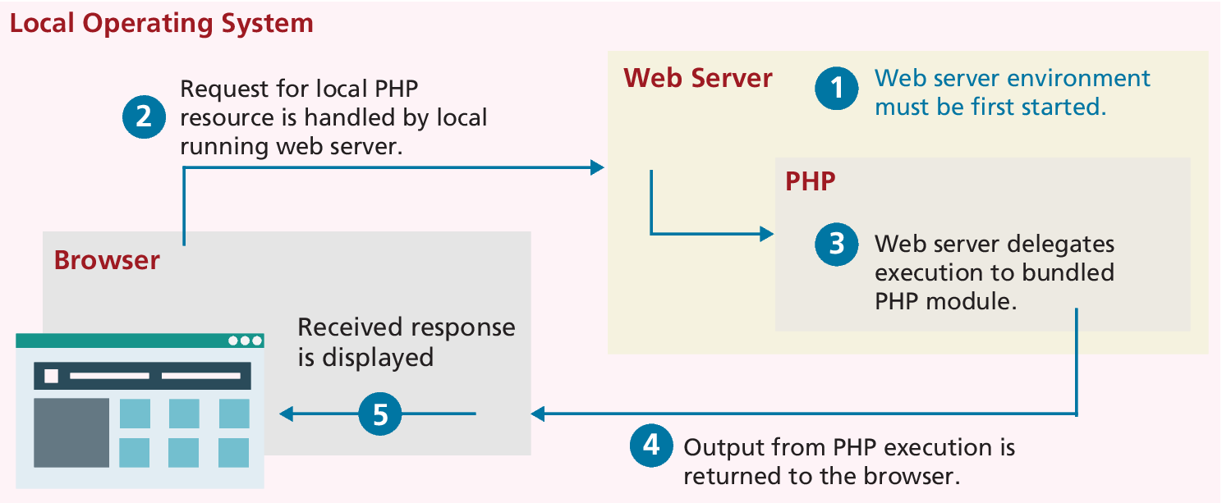
Running PHP locally
Installing Apache, PHP, and MySQL for Local Development

Slide 6
exercise
Your first php setup in local by flywheels

Slide 7
PHP Language Fundamentals
PHP is a a dynamically typed language (with optional static typing), and provides classes and functions in a way consistent with other object-oriented languages such as C++, C#, and Java.
The syntax for loops, conditionals, and assignment is identical to JavaScript, only differing when you get to functions, classes, and in how you define variables.

Slide 8
PHP Tags and comments
PHP code can be embedded directly within an HTML file. However, instead of having an .html extension, a PHP file will usually have the extension .php.
Code must be contained within an opening <?php tag and a matching closing ?> tag. Code within the <?php and the ?> tags is interpreted and executed, while any code outside the tags is echoed directly out to the client.
It is very common practice (especially when first learning PHP) for a PHP file to have HTML markup and PHP programming logic woven together.
PHP uses the same commenting mechanisms as JavaScript, namely multi-line block comments using /* */ or end-of-line comments using //

Slide 9
PHP Tag Example
<?php
$user = "Randy";
?>
<!DOCTYPE html>
<html>
<body>
<h1>Welcome <?php echo $user; ?></h1>
<p>
The server time is
<?php
echo "<strong>";
echo date("H:i:s");
echo "</strong>";
?>
</p></body></html>
<!DOCTYPE html>
<html>
<body>
<h1>Welcome Randy</h1>
<p>
The server time is <strong>02:59:09</strong>
</p>
</body>
</html>
LISTING 12.2 Output (HTML) from PHP script in Listing 12.1
LISTING 12.1 Php Tags

Slide 10
Variables and Data Types
Variables in PHP are dynamically typed. The PHP engine makes a best guess as to the intended type based on what it is being assigned.
Variables are also loosely typed in that a variable can be assigned different data types over time.
Boolean A logical true or false value
Integer Whole numbers
Float Decimal numbers
String Letters
Array A collection of data of any type (covered in the next chapter)
Object Instances of classes

Slide 11
Writing to Output
To output something that will be seen by the browser, you can use the echo() function.
echo("hello");
echo "hello"; //alternate version (no parenthesis)
Strings can be appended together using the concatenate operator, which is the period (.) symbol. Consider the following code:
$username = "Ricardo";
echo "Hello " . $username;
will output Hello Ricardo to the browser.

Slide 12
PHP quote and concatenation approaches
<?php
$firstName = "Pablo";
$lastName = "Picasso";
/*Example one:
These two lines are equivalent. Notice that you can reference PHP variables within a string literal defined with double quotes.
The resulting output for both lines is:
<em>Pablo Picasso</em>*/
echo "<em>" . $firstName . " ". $lastName. "</em>";
echo "<em> $firstName $lastName </em>";
/* Example two: These two lines are also equivalent. Notice that you can use either the single quote symbol or double quote symbol for string literals. */
echo "<h1>";
echo '<h1>’;
/* Example three: These two lines are also equivalent. In the second example, the escape character (the backslash) is used to embed a double quote within a string literal defined within double quotes. */
echo '<img src="23.jpg" >';
echo "<img src=\"23.jpg\" >";
?>
LISTING 12.4 PHP quote usage and concatenation approaches

Slide 13
Program Control
Just as with most other programming languages there are a number of conditional and iteration constructs in PHP.
if . . . else
switch . . . case
while and do . . . while
for

Slide 14
If…else
The syntax for conditionals in PHP is identical to that of JavaScript.
The condition to test is contained within () brackets with the body contained in {} blocks. Optional else if statements can follow, with an optional else ending the branch.
// if statement
if ( $hourOfDay > 6 && $hourOfDay < 12) {
$greeting = "Good Morning";
}
else if ($hourOfDay == 12) { // optional else if
$greeting = "Good Noon Time";
}
else { // optional else branch
$greeting = "Good Afternoon or Evening";
}
LISTING 12.7 Conditional snippet of code using if . . . else

Slide 15
PHP and HTML in the same script
<?php if ($userStatus == "loggedin") { ?>
<a href="account.php">Account</a>
<a href="logout.php">Logout</a>
<?php } else { ?>
<a href="login.php">Login</a>
<a href="register.php">Register</a>
<?php } ?>
<?php
// equivalent
if ($userStatus == "loggedin") {
echo '<a href="account.php">Account</a> ‘;
echo '<a href="logout.php">Logout</a>';
}
else {
echo '<a href="login.php">Login</a> ‘;
echo '<a href="register.php">Register</a>';
}
?>
LISTING 12.8 Combining PHP and HTML in the same script

Slide 16
switch . . . case
The switch statement is similar to a series of if ... else statements.
switch ($artType) {
case "PT":
$output = "Painting";
break;
case "SC":
$output = "Sculpture";
break;
default:
$output = "Other";
}
// equivalent
if ($artType == "PT")
$output = "Painting";
else if ($artType == "SC")
$output = "Sculpture";
else
$output = "Other";
LISTING 12.9 Conditional statement using switch and the equivalent if-else

Slide 17
For loops
The for loop in PHP has the same syntax as the for loop in JavaScript that we examined in Chapter 8. For loops contain the same loop initialization, condition, and postloop operations as in JavaScript.
// this one increments the value by 5 each time
for ($count=0; $count < 100; $count+=5) {
echo $count;
}
// this one increments the count by 1 each time
for ($count=0; $count < 10; $count++) {
echo $count;
}
LISTING 12.11 The for loops

Slide 18
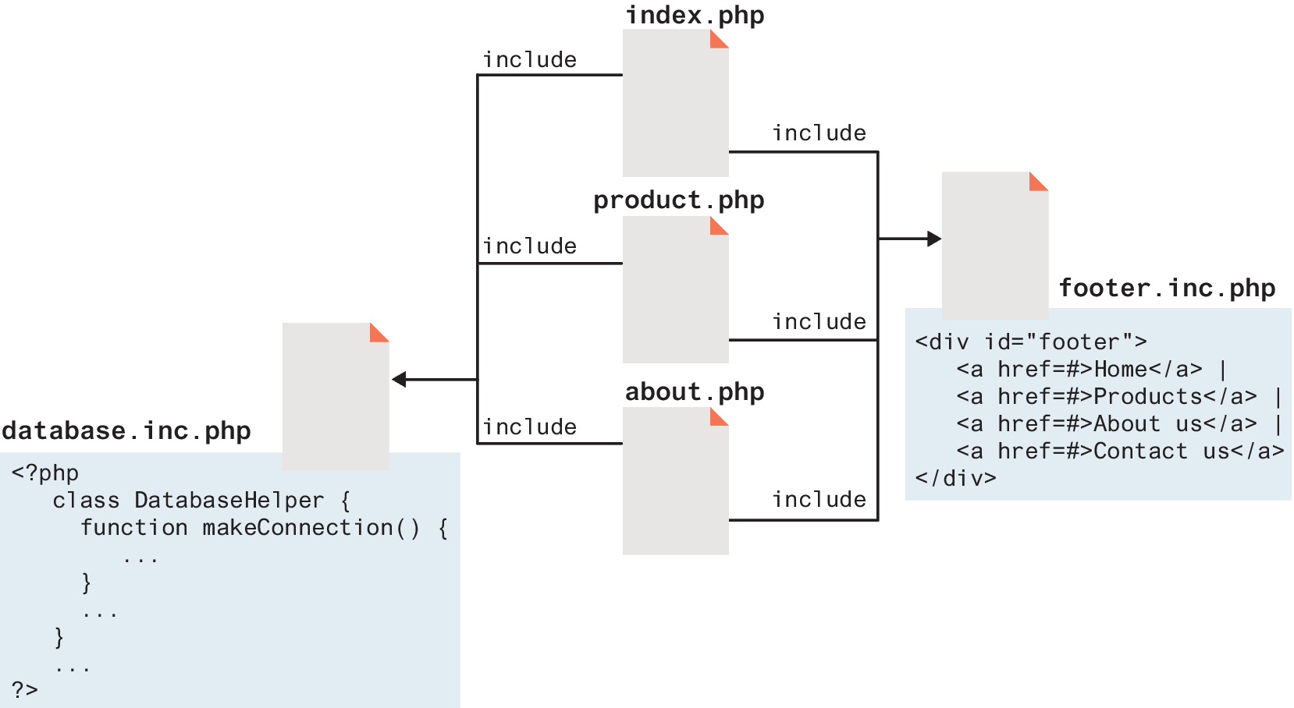
Include Files
PHP has the ability to include or insert content from one file into another. Include files provide a mechanism for reusing both markup and PHP code
include "somefile.php";
include_once "somefile.php";
require "somefile.php";
require_once "somefile.php";

Slide 19
Functions
Just like with JavaScript, a function in PHP contains a small bit of code that accomplishes one thing.
A user-defined function is one that you, the programmer, define.
A built-in function is one of the functions that come with the PHP environment (or with one of its extensions).

Slide 20
Function Syntax
Functions can return values to the caller, or not return a value.
They can be set up to take or not take parameters.
Function definition requires the use of the function keyword followed by the function’s name, round ( ) brackets for parameters, and then the body of the function inside curly { } brackets.
function getNiceTime(){
return date("H:i:s");
}

Slide 21
Invoking a Function
To invoke or call a function you must use its name with the () brackets. Since getNiceTime() returns a string, you can assign that return value to a variable, o echo that return value directly, as shown in the following example:
$output = getNiceTime();
echo getNiceTime();
If the function doesn’t return a value, you can just call the function:
outputFooterMenu();

Slide 22
Arrays
Unlike most other programming languages (including JavaScript), in PHP an array is actually an ordered map, which associates each value in the array with a key.
This allows you to use arrays in PHP in a manner similar to other languages’ arrays, but you can also use them like other languages’ collection classes.
Array keys restricted to integers and strings
Array values, unlike keys, are not restricted to integers and strings. They can be any object, type, or primitive supported in PHP.

Slide 23
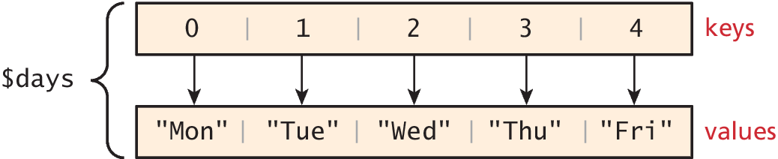
Defining an Array
The following declares an empty array named days:
$days = array();
To define the contents of an array as strings for the days of the week, you declare it using either of two following syntaxes:
$days = array("Mon","Tue","Wed","Thu","Fri");
$days = ["Mon","Tue","Wed","Thu","Fri"]; // alternate syntax

Slide 24
Iterating through an Array
// while loop
$i=0;
while ($i < count($days)) {
echo $days[$i] . "<br>";
$i++;
}
// for loop
for ($i=0; $i<count($days); $i++) {
echo $days[$i] . "<br>";
}
// iterating through the values
foreach ($forecast as $value) {
echo $value . "<br>";
}
// iterating through the values AND the keys
foreach ($forecast as $key => $value){
echo "day[" . $key . "]=" . $value;
}
LISTING 12.23 Iterating through an array using while, do while, and for loops
LISTING 12.24 Iterating through an associative array using a foreach loop

Slide 25

Classes and Objects
Classes outline properties and methods like a blueprint. Each variable created from a class is called an object or instance, and each object maintains its own set of variables, an behaves (largely) independently from the class once created.

Slide 26
$_GET and $_POST Superglobal Arrays
PHP uses special predefined associative arrays called superglobal arrays that allow the programmer to easily access HTTP headers, query string parameters, and other commonly needed information
$GLOBALS Array for storing data that needs superglobal scope
$_COOKIES Array of cookie data passed to page via HTTP request
$_ENV Array of server environment data
$_FILES Array of file items uploaded to the server
$_GET Array of query string data passed to the server via the URL
$_POST Array of query string data passed to the server via the HTTP header
$_REQUEST Array containing the contents of $_GET, $_POST, and $_COOKIES
$_SESSION Array that contains session data
$_SERVER Array containing information about the request and the server

Slide 27
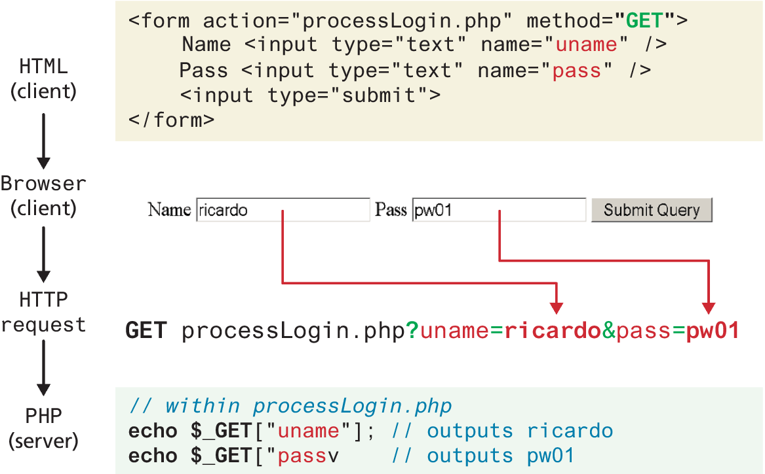
Illustration of flow into $_GET array

Slide 28
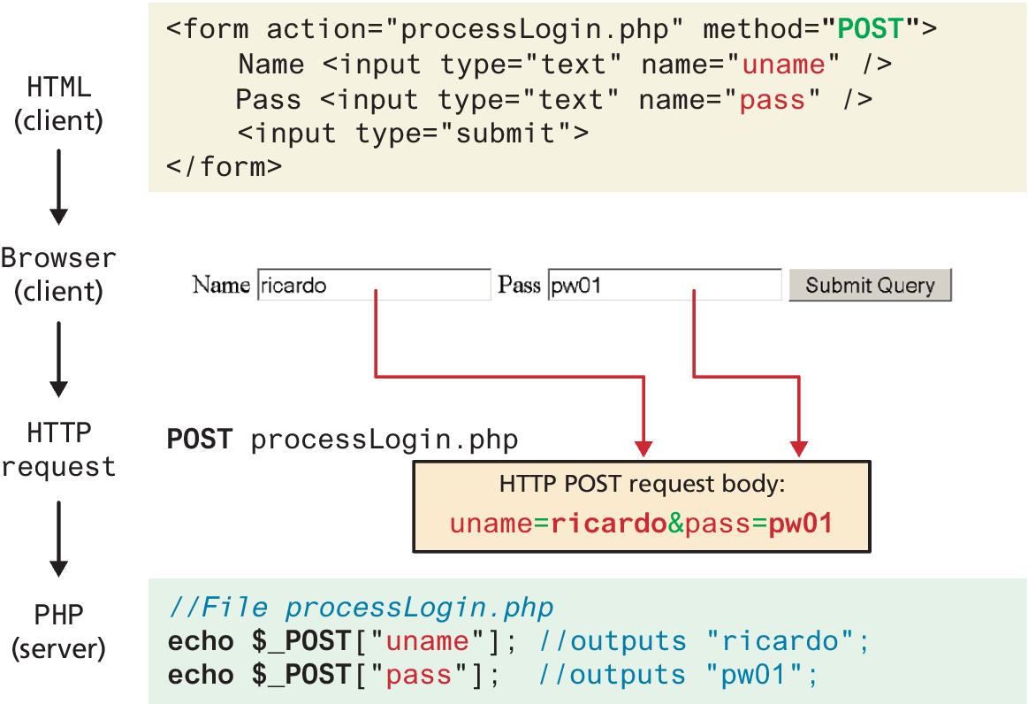
Illustration of flow into $_POST array

Slide 29
Accessing Form Array Data
Sometimes in HTML forms, you might have multiple values associated with a single name. Unfortunately, if the user selects more than one day and submits the form, the $_GET['day'] value in the superglobal array will only contain the last value from the list that was selected.
To overcome this limitation, you must change the HTML in the form. In particular, you will have to change the name attribute for each checkbox from day to day[]
echo "You submitted " . count($_GET['day']) . "values";
foreach ($_GET['day'] as $d) {
echo $d . " <br>";
}
LISTING 12.34 PHP code to display an array of checkbox variables

Slide 30
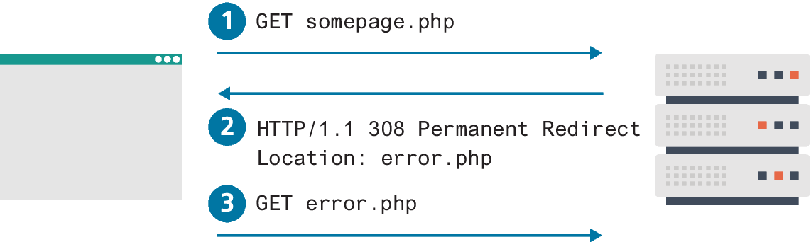
Redirecting Using Location Header
One of the most common uses of this function in PHP is to redirect. For instance, a PHP page might redirect to an error page when an expected querystring parameter is missing
<?php
if (! isset($_GET['id']) {
header("Location: error.php");
}
...?>

Slide 31
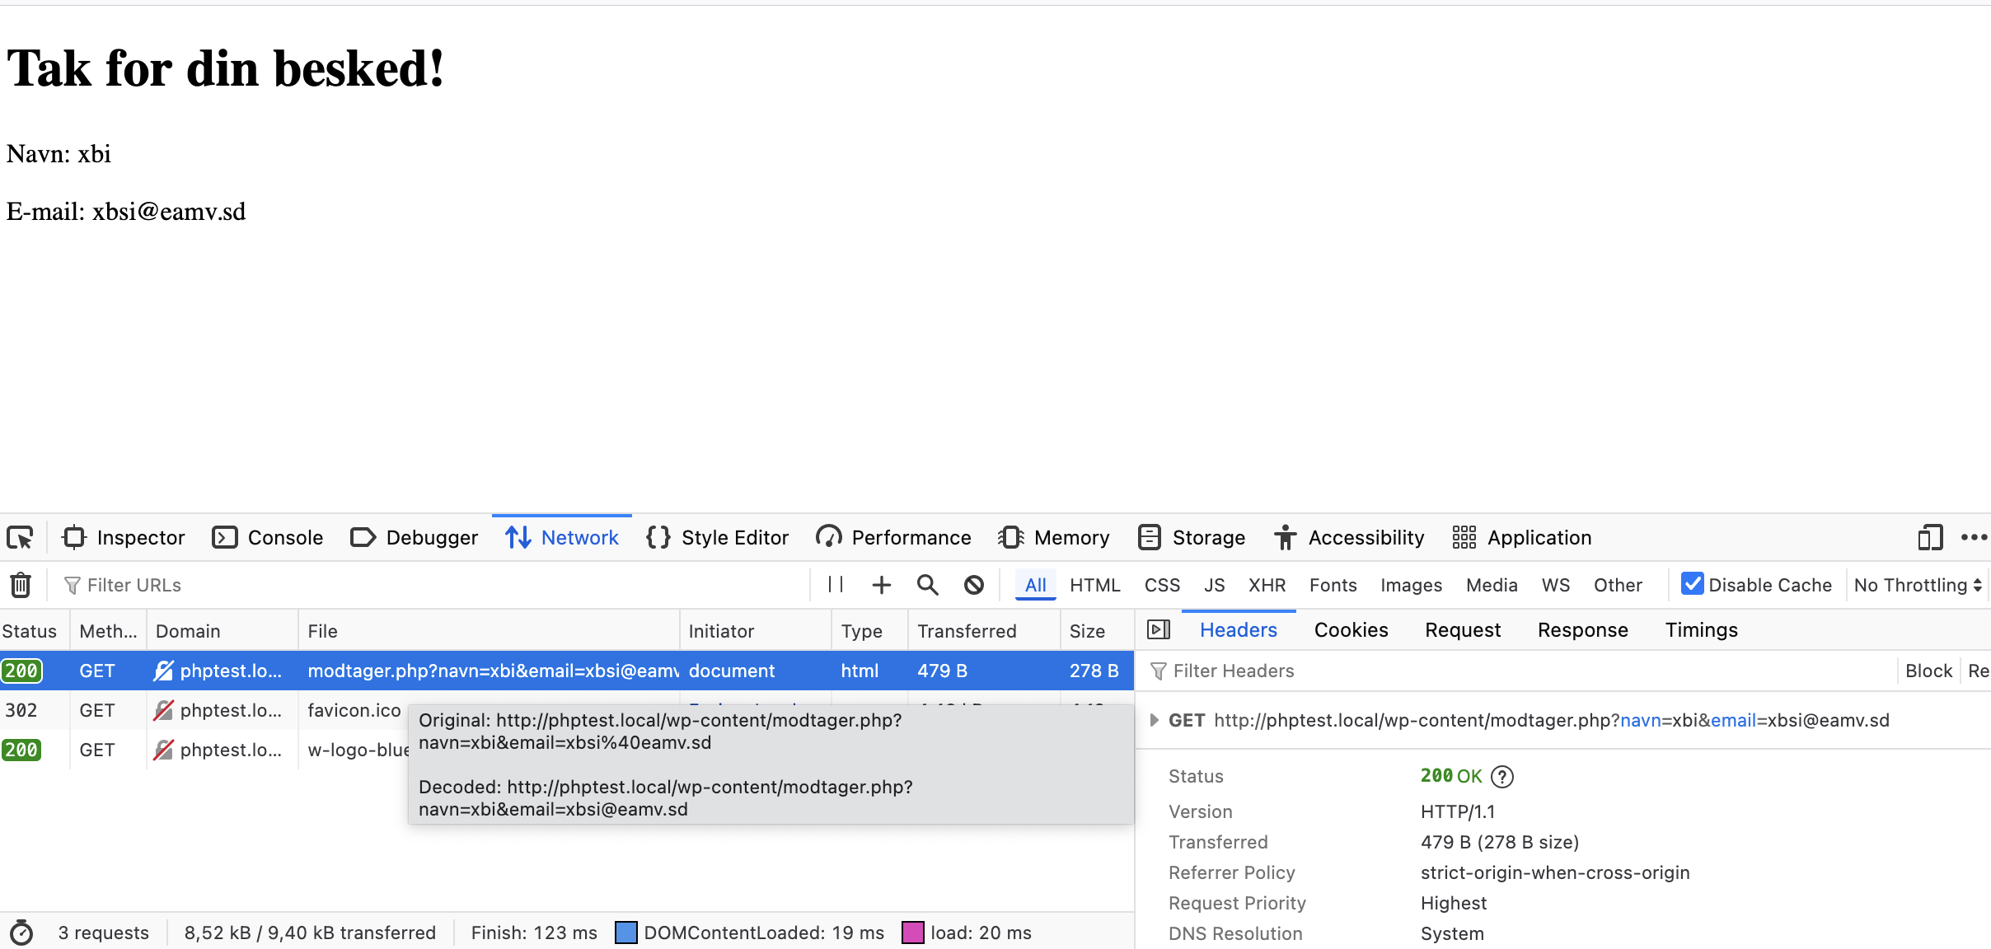
Get can be dangerous
https://koder.systime.dk/?id=140&L=1#c768

Slide 32
Reflection- Why the hacker always send a suspious link?

